Slide 1
Assimilation of Mars Climate Sounder dust observations: Challenges and ways forward
Paul Streeter, Stephen Lewis, Manish Patel, & James Holmes
The Open University

Slide 2
Mars DA at the Open University
Have assimilated:
Temperature profiles (e.g. Lewis et al., 2007) [TES, MCS]
Dust column (e.g. Lewis et al., 2007) [TES, MCS]
H2O vapour column (e.g. Steele et al., 2014a) [TES]
H2O ice profiles (Steele et al., 2014b) [MCS]
Ozone column (Holmes et al., 2018) [SPICAM]
And investigated (for example):
Thermal tides (Lewis & Barker, 2005)
Dust storms (Montabone et al., 2005)
Water cycle (Wilson et al., 2008, Steele et al., 2014a,b)
Solsticial pause (Lewis et al., 2016)
Ozone distribution (Holmes et al., 2018)

Slide 3
The Analysis Correction (AC) scheme
Repeated insertion of observations into LMD-UK Mars GCM
Analysis performed between every dynamical timestep
Aims to minimise error function between model and retrievals
Computationally inexpensive
$$X_{n+1}=X_{n}+W\tilde{Q}(y_{o}−H\left(X_{n}\right))$$
Model increments
Normalisation
Spreading to model grids

Slide 4
The Analysis Correction (AC) scheme
Observations given weighted radius of influence in time and space, with maximum weighting at valid time of observation
Spatiotemporal correlation functions determined empirically
Good for maximising utility of relatively sparse data
Steele, 2014

Slide 5
The Analysis Correction (AC) scheme
AC scheme in action: applying dust column increments to represent MY 29 regional storm seen by MCS

Slide 6
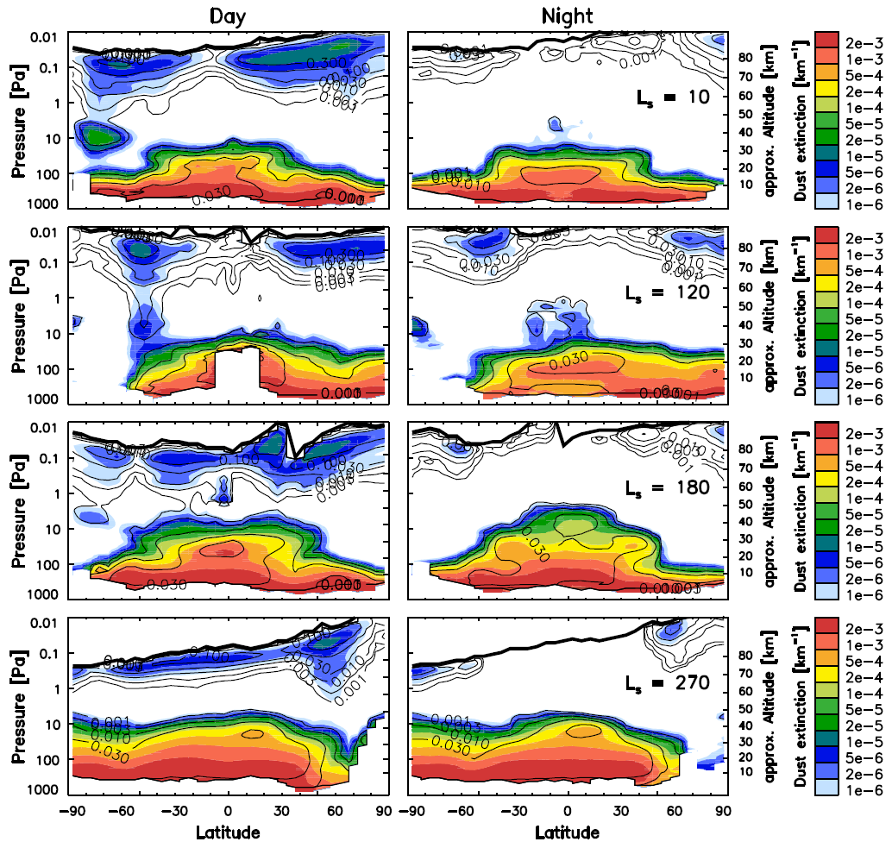
The MCS dust dataset
5+ martian years of profiles
Dust extinction at 463 cm-1
Intrinsic vertical resolution of ~5 km
Range of ~8 km to ~50 km above the surface
Latest retrieval version uses 2D geometry, with better results near the poles (Kleinböhl et al., 2017)
Column products available: extrapolate from last valid data using well-mixed assumption (Montabone et al., 2015)
Kleinböhl et al., 2015

Slide 7
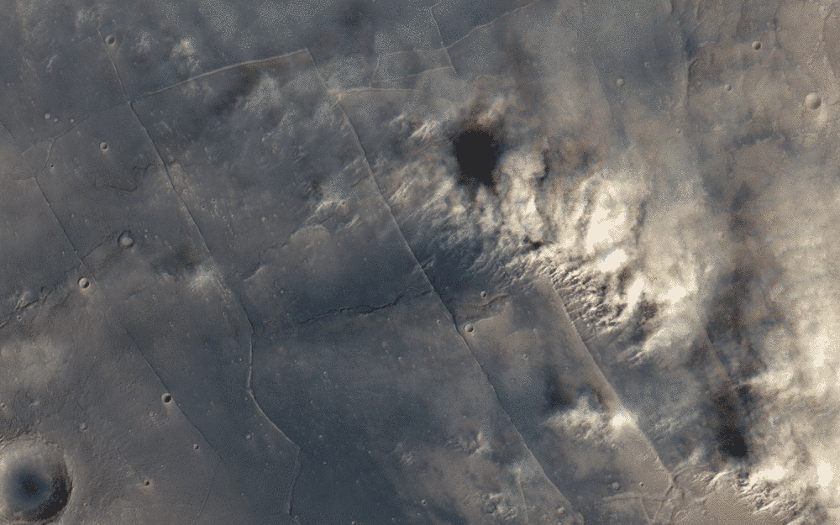
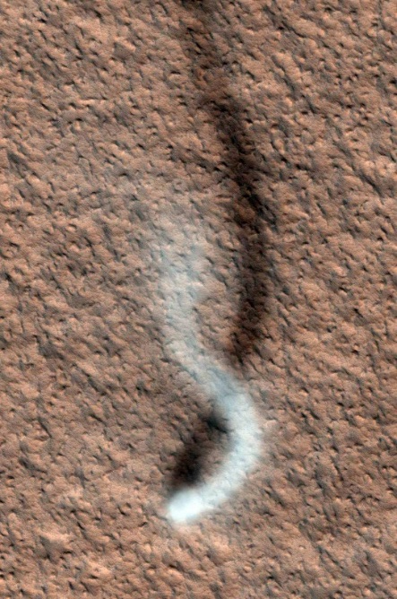
Benefits of assimilating dust profiles
More realistic vertical dust distribution in our model runs and reanalyses
Study dust behaviour in the vertical
Study dust lifting and transport more generally in greater detail
Study dust impacts on the atmosphere as a whole (e.g. wave activity)
Study dust-ice interactions and how they can be better represented in modelling
NASA/JPL-Caltech/Cornell/USGS
NASA/JPL-Caltech/University of Arizona
ESA/DLR /FU Berlin (G. Neukum)/Justin Cowart

Slide 8
My work
Ongoing
Coupled: dust advected by model
Currently using MCS columns as well as profiles
Looking for independent constraints!
THEMIS, CRISM, (eventually) ACS (?)/NOMAD
Vertical analysis adapted from Steele (2014)
Lifting on: de facto dust injection in boundary layer

Slide 9
My work
How it works:
Obs processing
MCS profiles are read in on 105 pressure levels
Profiles are moved to equally-spaced eta levels
Opacities are converted from extinction at IR to absorption at 600 nm with scaling factors
Filtering is performed (more later)
Data is written to binary files
Analysis
Obs files are read by the AC scheme
Vertical analysis is performed: opacities are moved to model vertical coordinates, interpolation and extrapolation are carried out
Horizontal analysis is performed
Assimilation increments are calculated and added to model field
Coupling to model physics (trickiest bit!)
Scaling applied to model mass fields
Transport and radiative physics calculated and applied (LMD-UK MGCM v6)

Slide 10
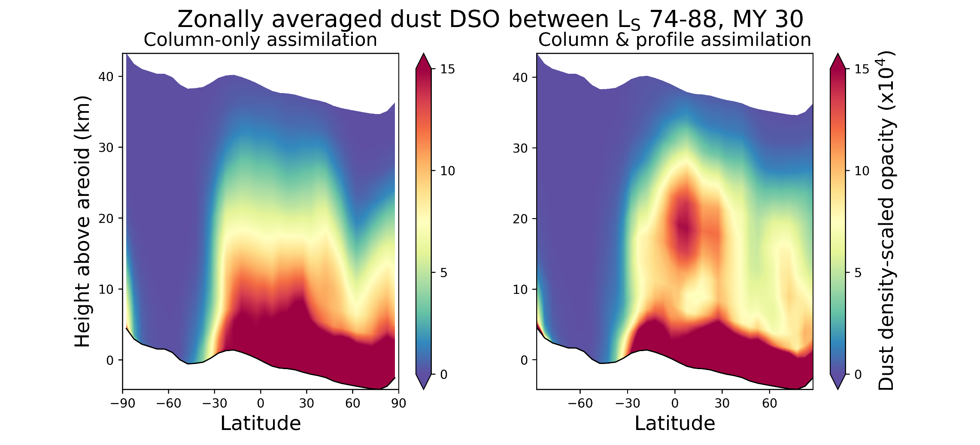
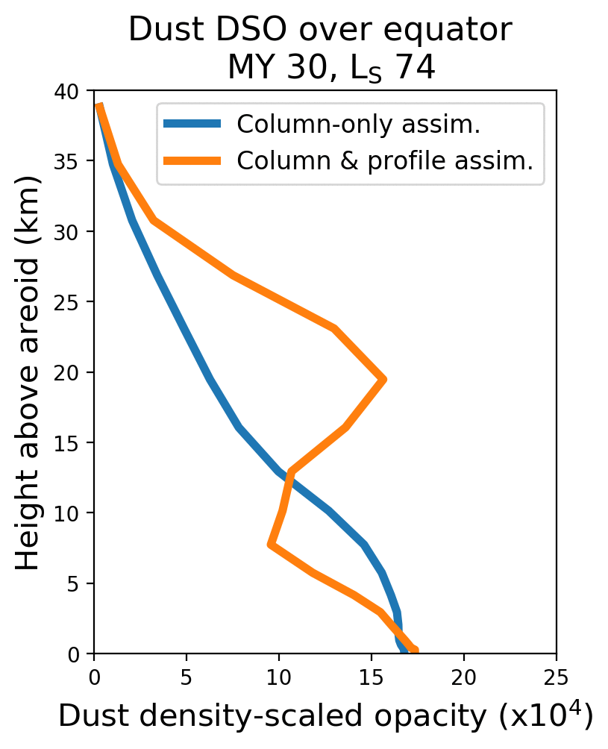
My work
DDLs
DDLs

Slide 11
Challenge: bottom ~10 km
Currently, use MCS-derived columns to constrain: this assumes well-mixed distribution
Both free-running model and show higher DSO’s near surface than Conrath assumption still used in MACDA; more similar to each other than MACDA
Previous experiments of mine have shown that having no column constraints can lead to runaway dust distribution, as dust collects near the surface (lifting and deposition)
Previous experiments of Ruan (2015) have shown that profile-only assimilation gives a poor representation of the spatial dust distribution
Better to use MCS columns and their implicit assumptions (my work so far), or the more sparse but independent THEMIS dataset (Ruan 2015)? Or both? Or neither (Navarro et al., 2017)?

Slide 12
Challenge: bottom ~10 km
Modified Conrath
Freely-evolving
Profile assimilation

Slide 13
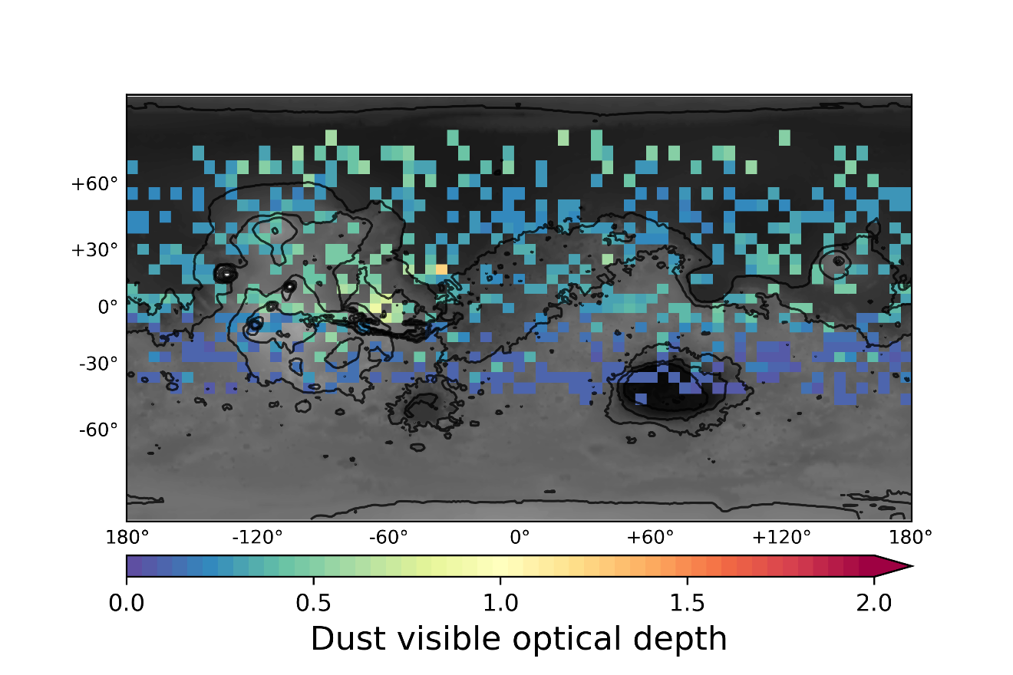
Challenge: bottom ~10 km
MCS
THEMIS

Slide 14
Challenge: day/night obs
Night obs are cleaner; however, would miss forcing during the day
Should we use both? Have the “option” to switch for specific purposes? Is this something that would be desirable?
Should we have both but treat day differently? The AC scheme can easily add error to an obs type, but is currently agnostic

Slide 15
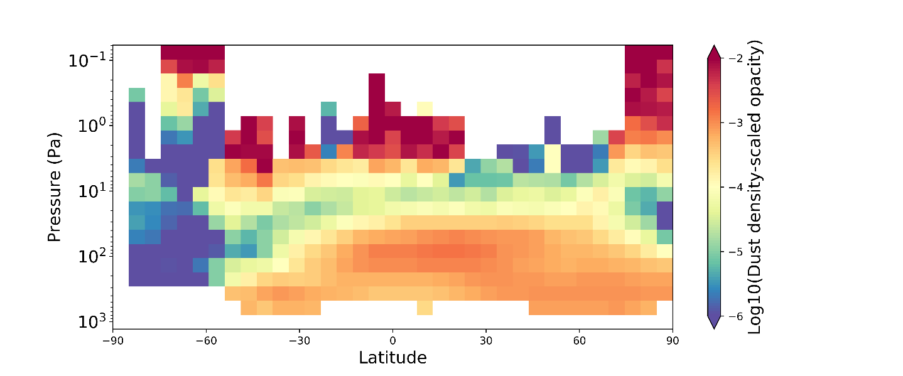
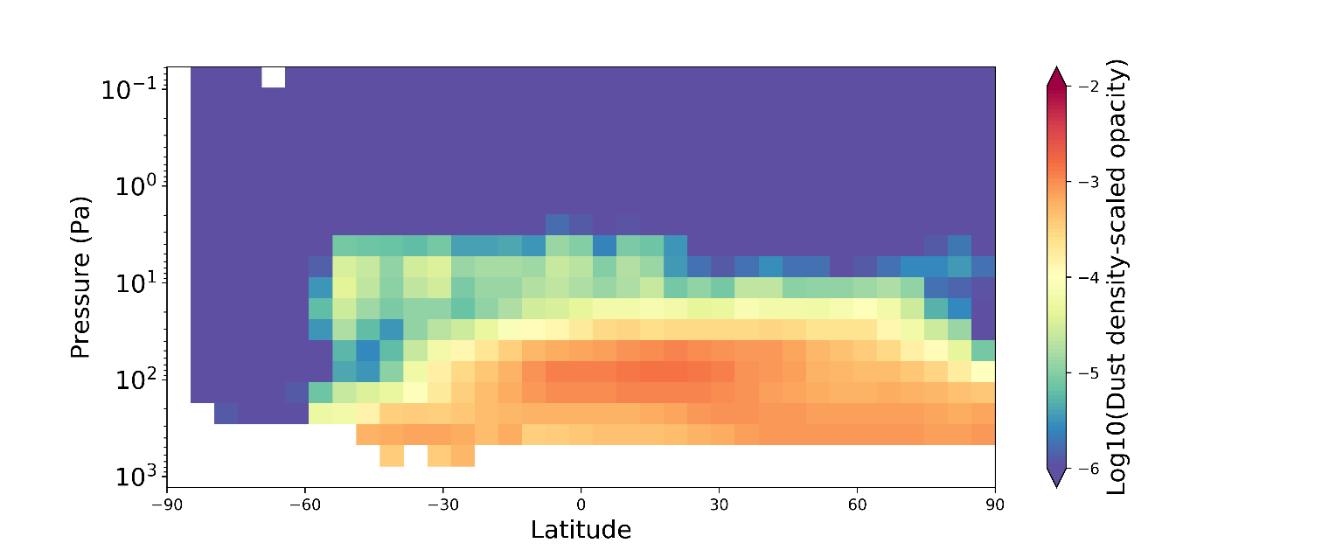
Challenge: filtering and processing of obs
Unfiltered DSO obs, L_{S} ~75
Some filtering is necessary as working in DSO space means very low pressures near the TOA and hence occasional spuriously high DSO, especially on dayside
Currently filter smoothly from about ~50 km (ie. top of MCS range and location of spurious opacities described by Kleinböhl et al. (2015))
Still get dust “bulge” during aphelion: is this physical? Is it even worth trying to filter? Only really visible in log scale, but could affect calculations of transport
Filtered DSO obs, L_{S} ~75

Slide 16
Challenge: filtering and processing of obs
Assimilated DSO, L_{S} ~75

Slide 17
Challenge: model vertical resolutions
How many vertical levels are best? Does it matter?
Worth spacing out sigma levels differently to focus on DDLs?
How many levels does the community want/need to do science?
Some experimental results indicate that 50+ levels help to “smooth out” strange features e.g. the dust bulge describes earlier, generally ensure a smoother distribution, and also enhance detachedness of DDLs

Slide 18
Challenge: constraining scaling
Scaling of model mmr currently capped at +/-5% for each assimilation step to prevent instabilities
Smaller increments result in more physically reasonable looking dust distributions at ~40+ km, but also have less prominent DDLs
Anything above ~20% leads to haywire distributions and model crashes, presumably as too much dust is added in “anomalous” DSO gridboxes but isn’t sufficiently sedimented away
Tighter constraint better representation of “average”, but maybe misses real anomalous events?

Slide 19
Challenge: quantifying transport
How to characterise transport when the AC scheme is constantly adding and removing dust? What diagnostics?
Should we try to characterise transport through mass field or could it be possible to diagnose from opacity field?
In the AC scheme, dust field is not conservative
Normally is not conserved in a column sense (scaling), but is conserved in a relative sense within the vertical distribution

Slide 20
Conclusions
Main challenge is coupling: converting measured opacities into the mass mixing ratios we need in the model
Vertical resolution: using 50+ model levels seems to give better representation of the detached nature of DDLs, as well as smoother distribution at ~40+ km
Scaling factor: keep below ~10% to avoid unphysical behaviour. Tradeoff between tighter prescription (smoother, more model-like distribution) and looser (a bit less smooth, enhanced DDLs).
Dust below MCS range: need column constraints of some sort, ideally independent (to capture dust activity within PBL), but implicitly analytical is better than nothing
Filtering/processing: needed for conversion to DSO space, but open question on how to deal with dust bulges
For realistic vertical dust, should start moving away from modified Conrath

Slide 21
Overall challenges
Coupling to model dust physics
Opacity or DSO?
Mass field or opacity field, what matters most?
Does vertical resolution/sigma level distribution matter?
How much to constrain scaling?
Handling observations
How to represent dust out of range (<~10 km)? Lifting or off? Yardstick for lower-atmosphere dust?
How to deal with possible artefacts, especially if relatively “small” (only visible on log-scale)? Filter or let be?
Future profiles: how to deal with disagreements (e.g. NOMAD-MCS disagreement)?
Dust-ice interactions
What does the community want from a 3D dust climatology? One-size fits all, or tunable options?
E.g. day/night obs only; different filtering
Is it most important to get the mass field right or the opacity field, in the case of tradeoffs having to be made?
How do you want it validated?

